Slide 1


HEALTH CLINIC BOT “Your Health ally!”
Team Members:
Seth Emery
Shreyan Reddy Gangwar
Lavanya Ghanathey
Ankitha Srirama Reddy

Slide 2
Abstract
Welcome to our Health Clinic Locator, your personalized healthcare companion! Enter your postal code, and we'll guide you to top-rated hospitals tailored to your needs. Uncover essential details such as insurance acceptance, convenient opening hours, and the availability of emergency services. Our goal is to empower you with the information needed to make informed healthcare decisions. Your well-being is our priority – type in your postal code and embark on a journey to optimal healthcare.

Slide 3
OBJECTIVE
Our objective is to guide individuals to top-rated hospitals that align with their specific needs. We strive to offer a comprehensive overview, including insurance acceptance, convenient opening hours, and the availability of emergency services, ensuring users make informed decisions about their healthcare choices. Through this platform, our goal is to enhance accessibility and facilitate well-informed healthcare decisions for all users.

Slide 4
Data COLLECTION
Our data set is a hospital data set that is collected from the web, based on the hospital type. The features in our data set are: Hospital Name, Hospital Type, Address, City, State, Postal Code, Email, Contact, Rating, Doctor's Name, Facility Type, Insurance, Emergency Service, Opening Hours, Latitude, Longitude, Web site URL.

Slide 5
Data Preprocessing
As part of data preprocessing, we are changing our raw data file which is in excel format to CSV file. Then we are finding if there are any missing values in our data set and are replacing all the missing values with NA. Then we are removing all the leading and trailing spaces from each string from the selected columns that are of type string. Further, we are renaming all the columns with meaningful names and then we are saving the cleaned data to a new CSV file in the data_clean folder.

Slide 6
BOT functionalities
First bot requests for the username, then asks the user to select the facility type and then requests the user for the pincode. Later based on the pincode provided by the user, the bot displays all the hospitals in the pincode specified by the user based on the rating of the hospital i.e., the top-rated hospital will appear first in the list. Then the displayed hospitals will be visualized on the map.

Slide 7
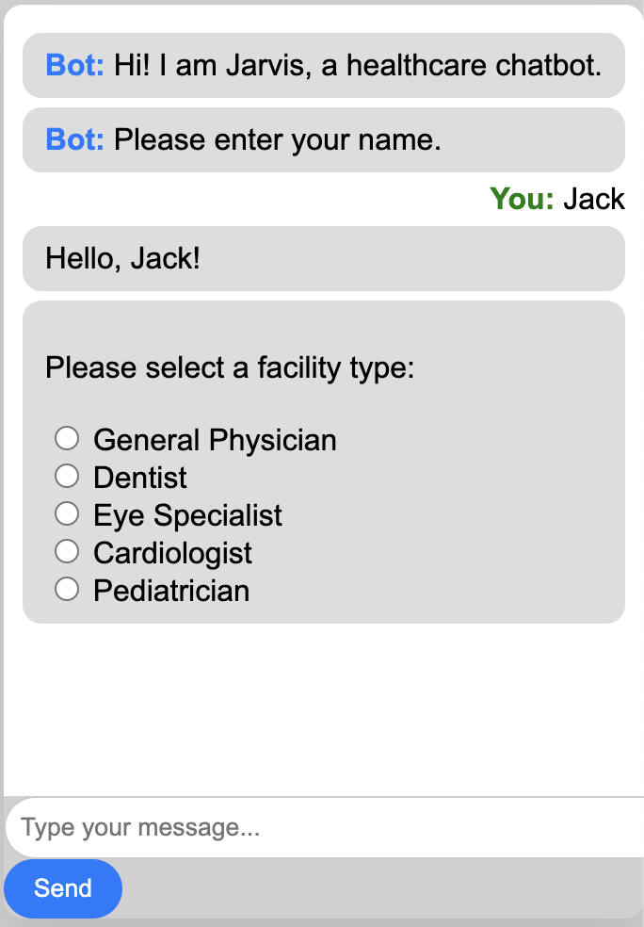
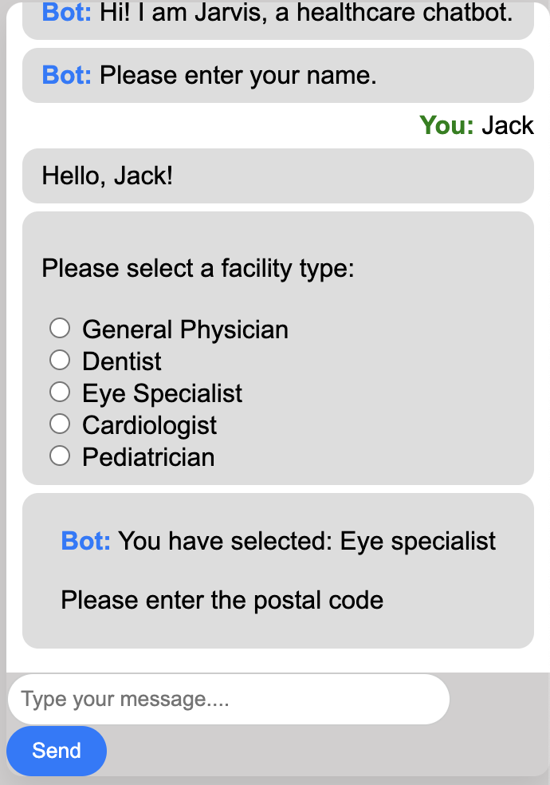
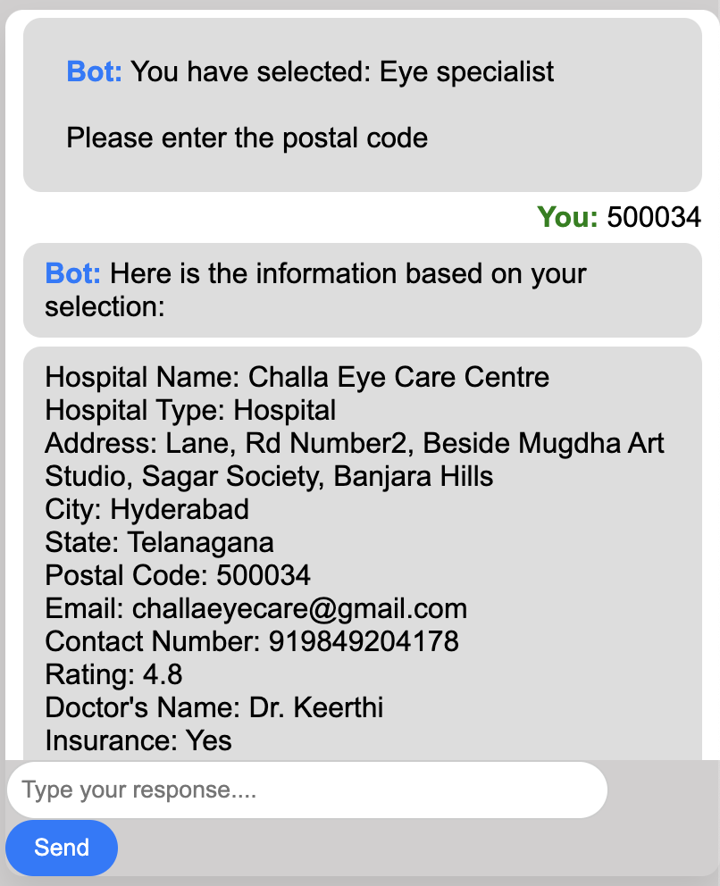
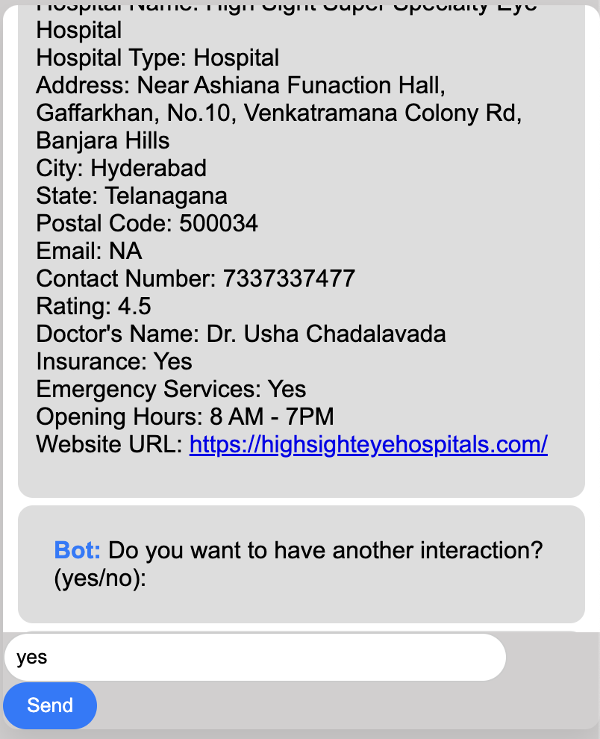
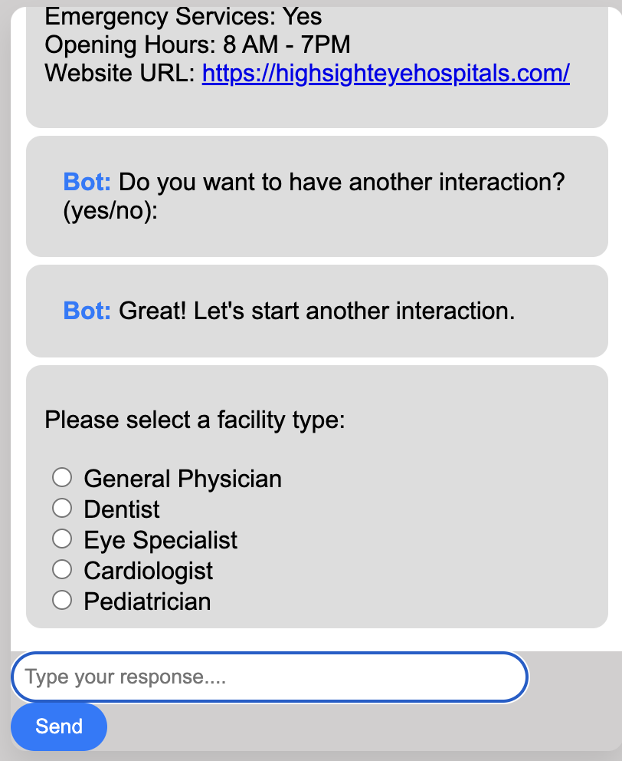
Results

Slide 8
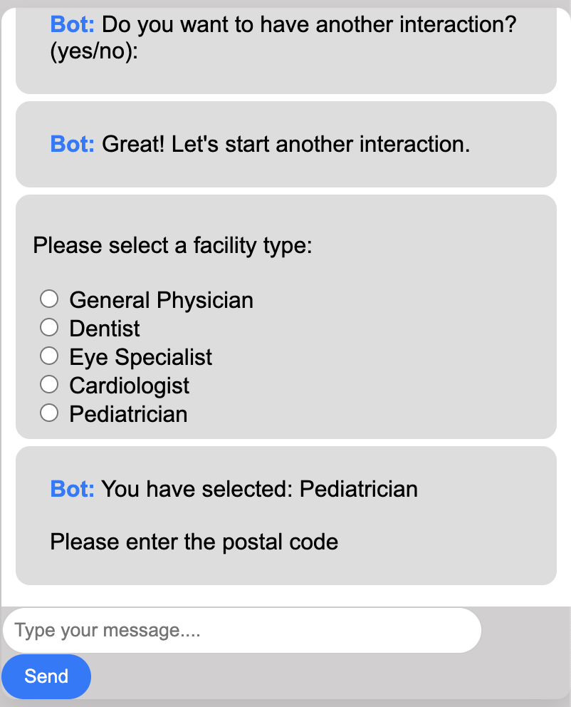
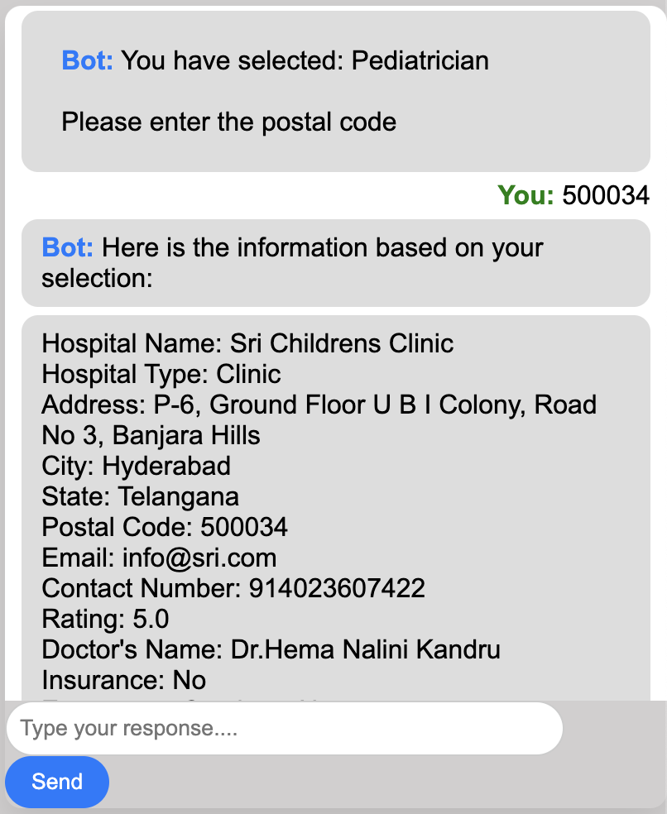
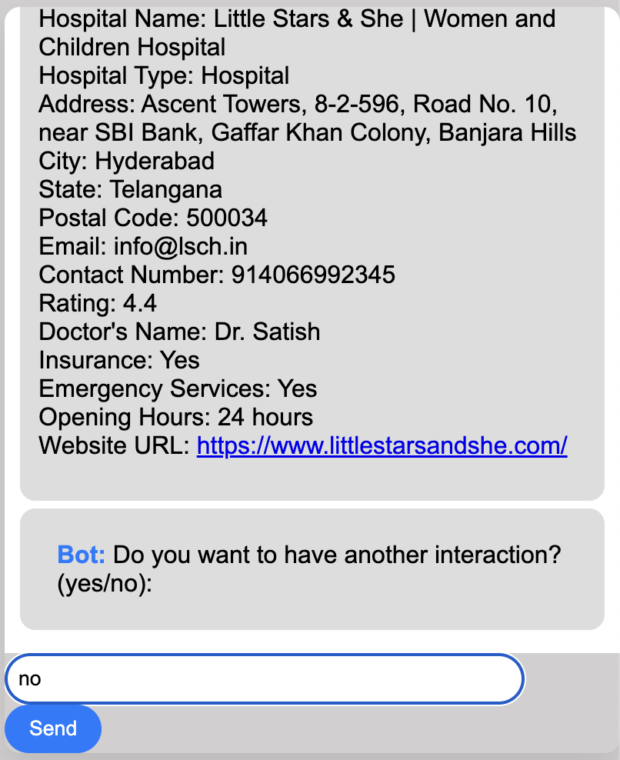
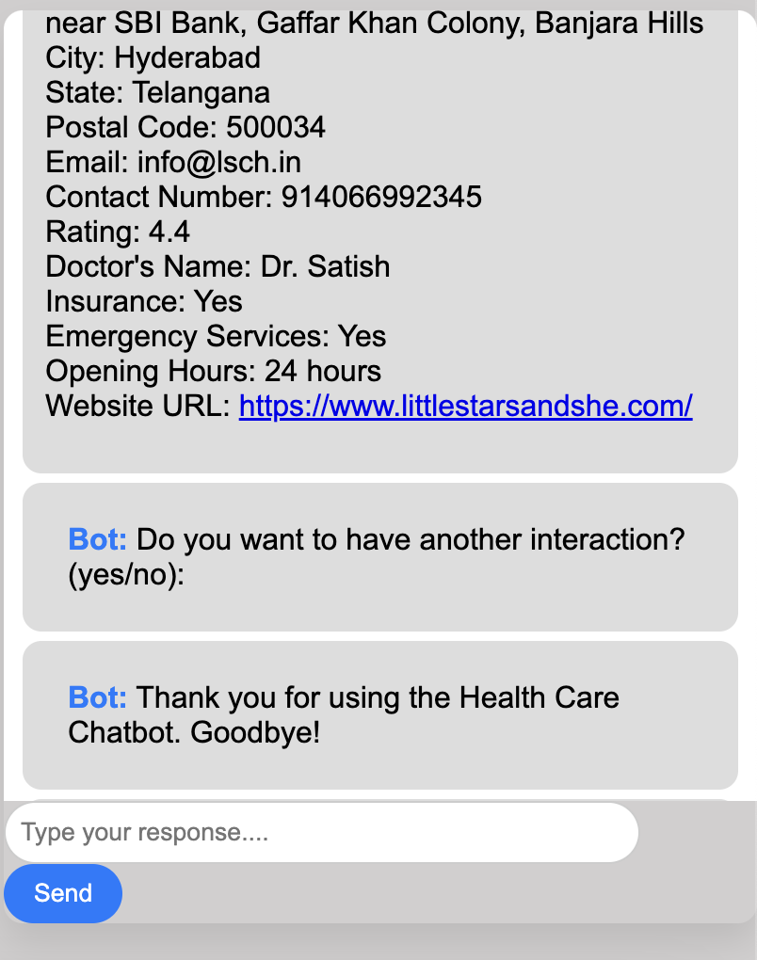

Slide 9
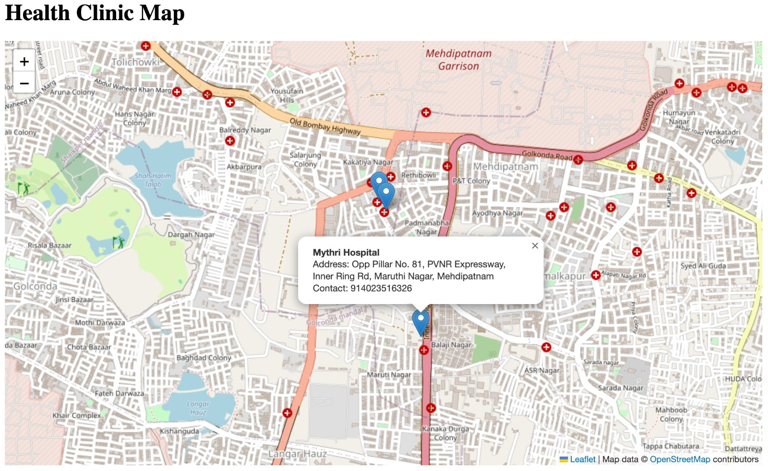

Slide 10
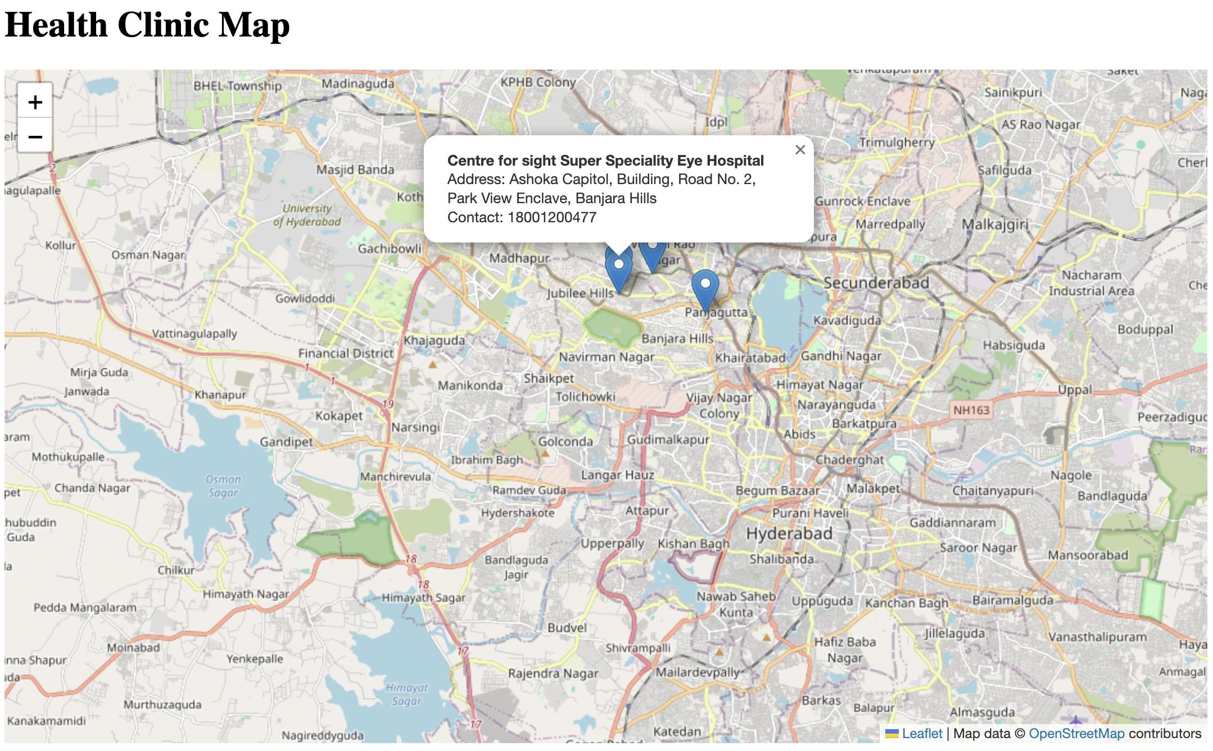
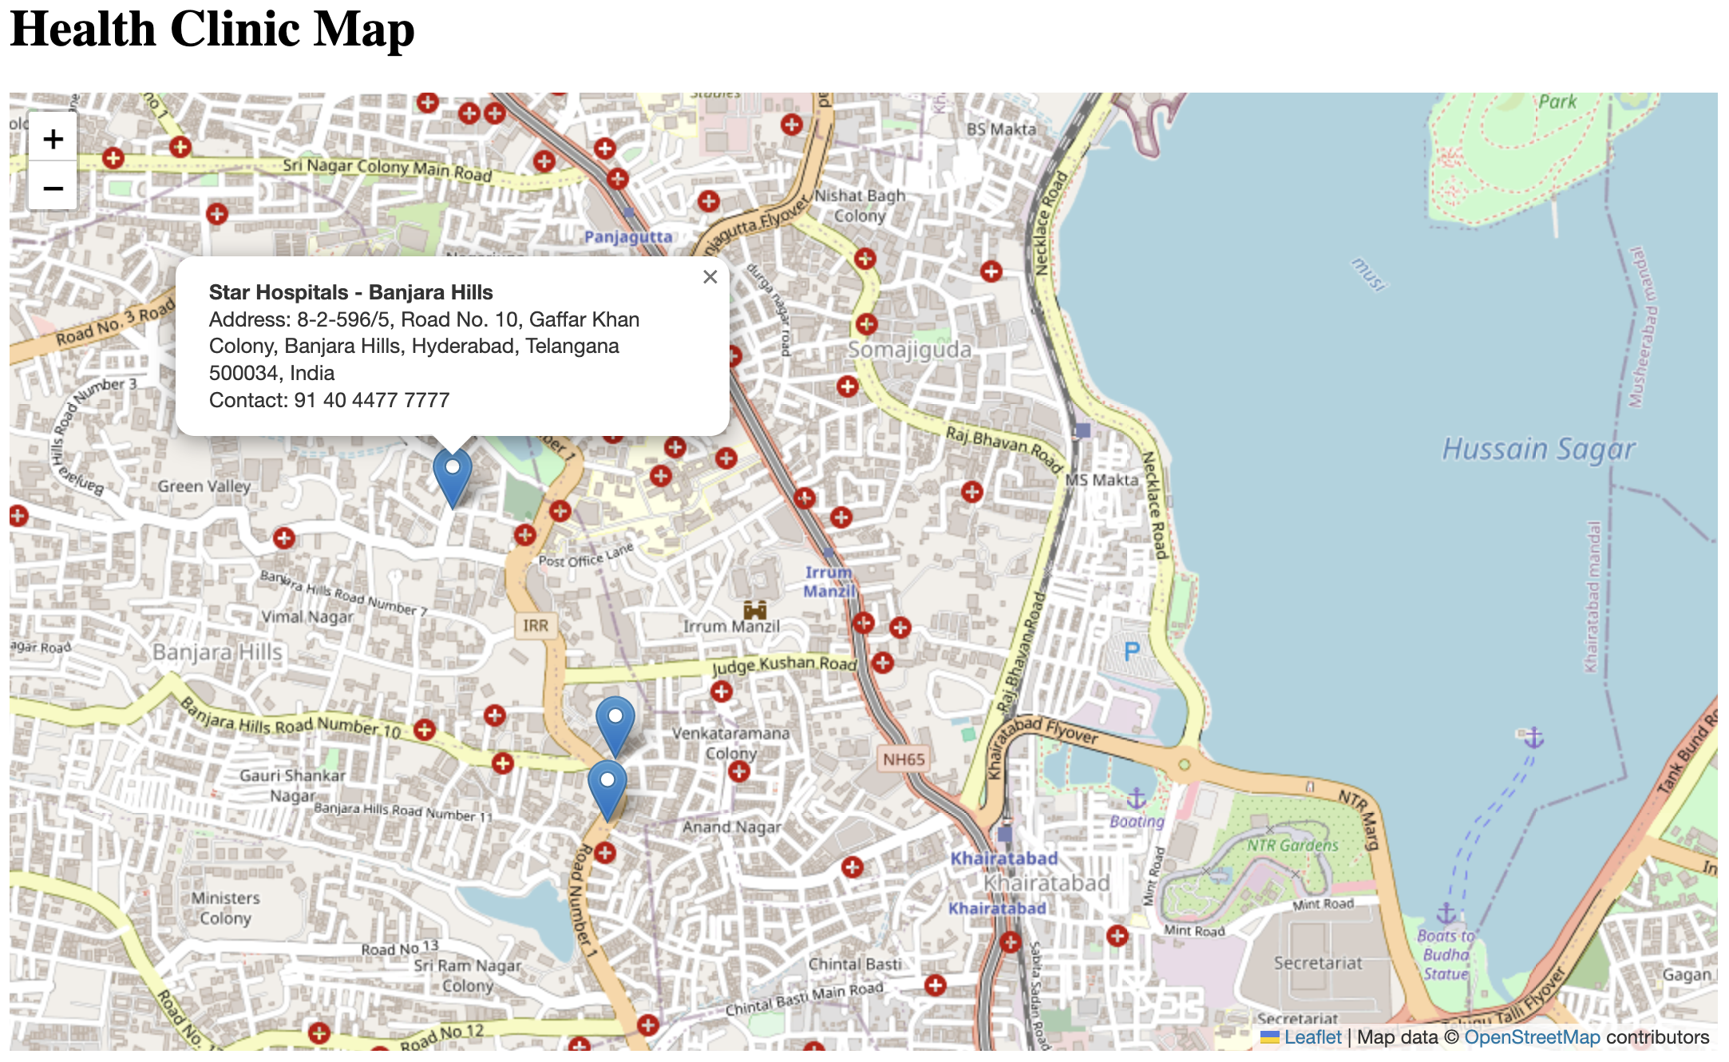

Interactive maps are created using Leaflet JS

Slide 11
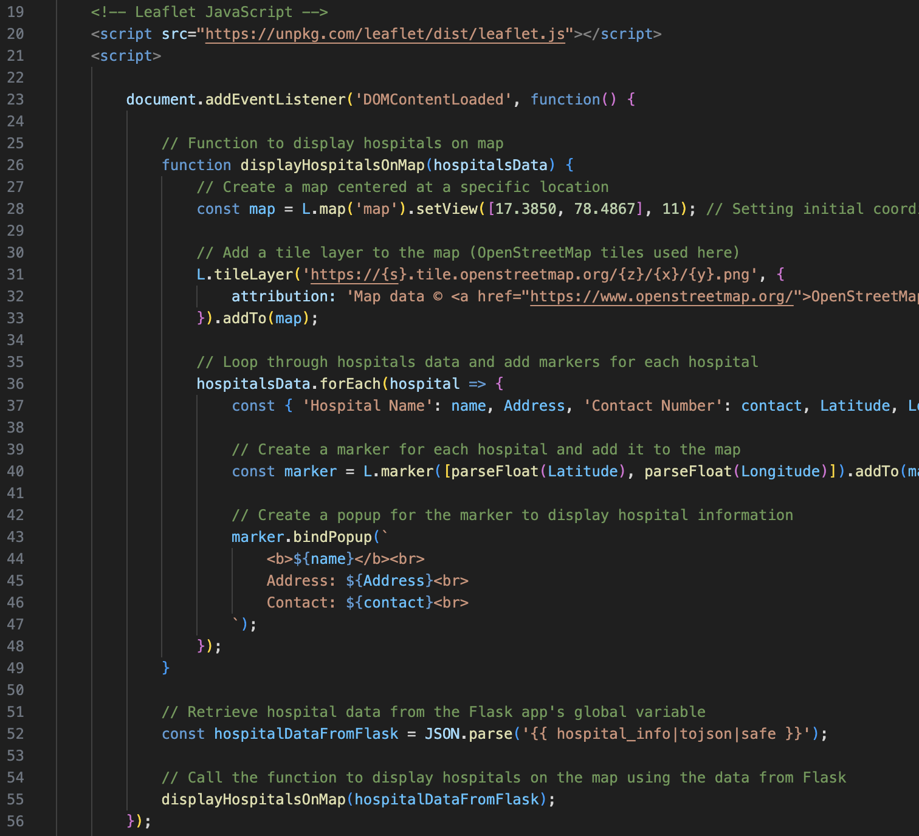
Creating Maps
Map object created with L.map()
Setting the initial view
Creating markers for each coordinate with L.marker()
Popups created with bindPopup()

Slide 12
Future Scope
Appointment Booking
Medication Suggestions

Slide 13
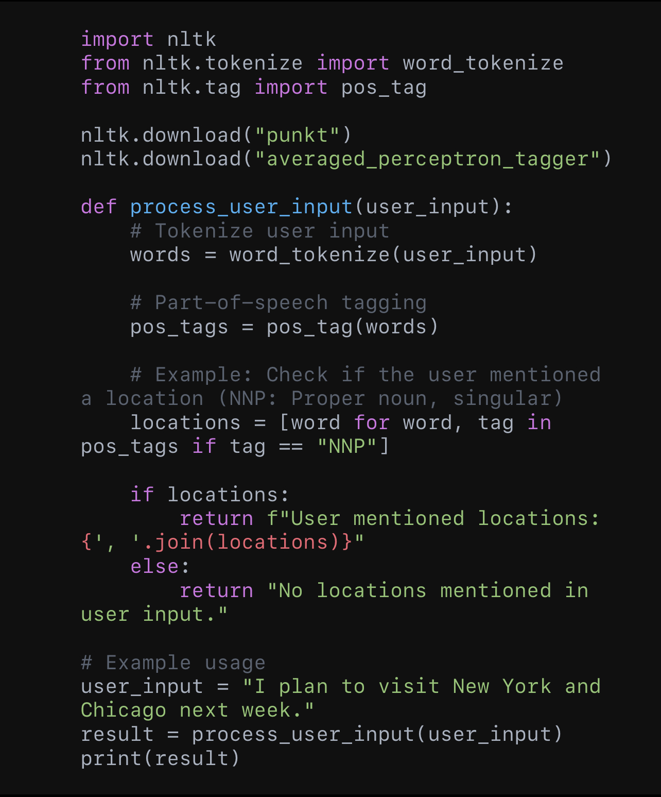
Future Scope
Adding Natural Language Processing functionality to the Health Clinic Locator
NLP basics implemented with the NLTK library (tokenization, part-of-speech tagging)
Gradually expand NLP capabilities over time using Natural Language Toolkit

Slide 14





Advanced similar projects/companies

Slide 15
THANK YOU!!!

